Slide 1
IT News Site – Project 5
By Chris Pinto, Will Stamp and Terrance Power

Slide 2
Group Members
Chris Pinto – How Russia’s Attack Affects Crypto
William Stamp – Digital Currency Revolution
Terrance Power – Auto Manufacturing During Ukraine Crisis

Slide 3
Digital Currency
Digital Currencies & Economic Transformation
Digital currencies are poised to have a long-lasting impact on the financial system.
China is leading global blockchain adoption for digital transformation.
Design, governance and provision of sufficient liquidity are among the key principles that are important to get right.
Digital transactional platform will provide financial inclusion to parts of the world that need it the most.

Slide 4
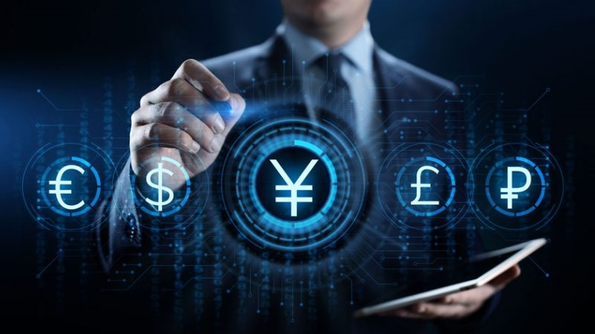
The Rise of Digital Currency and Its Impact on the Global Economy
Most of the money we use is already electronic.
Digital Currencies are likely to replace fiat currencies.
New technologies typically bring some big challenges.
Central bank digital currency (CBDC) and financial inclusion.

Slide 5
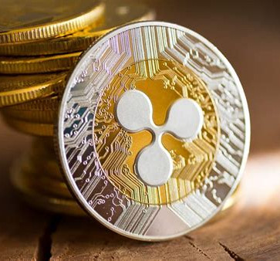
5 Ways Digital Currencies Will Change The Financial Landscape
Cross-Border Payments are faster, more efficient and cost effective.
Alternative reserve currencies In unstable economies.
Digital currencies have a lower transaction cost and greater security and scalability than fiat money.
Giving more power to the people.
Doing away with the need for currency exchange.

Slide 6
Russia's attack on Ukraine had sent cryptocurrency prices tumbling!
As the world reeled from Russia's long-expected invasion of Ukraine, the backlash had a disastrous impact on the prices of Bitcoin, Ethereum, and nearly every other major cryptocurrency.
The total cryptocurrency market has lost approximately 5% in the first 24 hours, standing at $1.6 trillion.
The crypto economy fell to $1.71 trillion with a global trade volume of $78 billion.

Slide 7
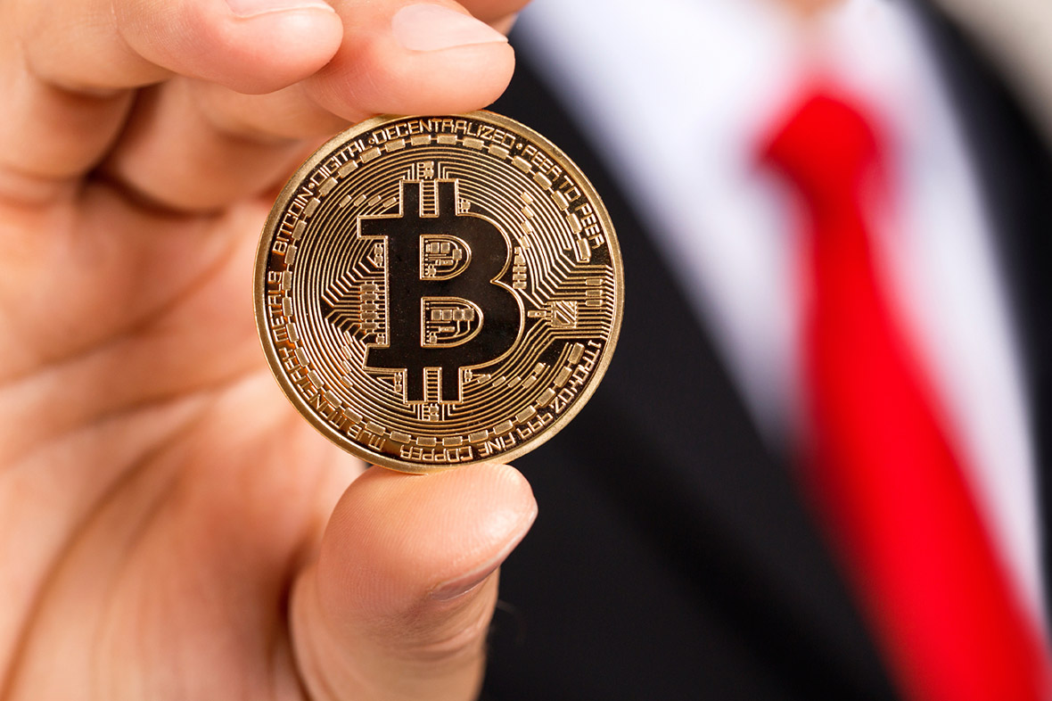
How is Crypto Today?
Bitcoin and other cryptocurrency prices are jumping following a plunge this week in the value of Russia's currency
Bitcoin on Wednesday rose to $44,188 after falling as low as $36,370 last week.
Other leading cryptos, including Ethereum, Ripple and Solana, were either flat or saw gains of at least 2%

Slide 8
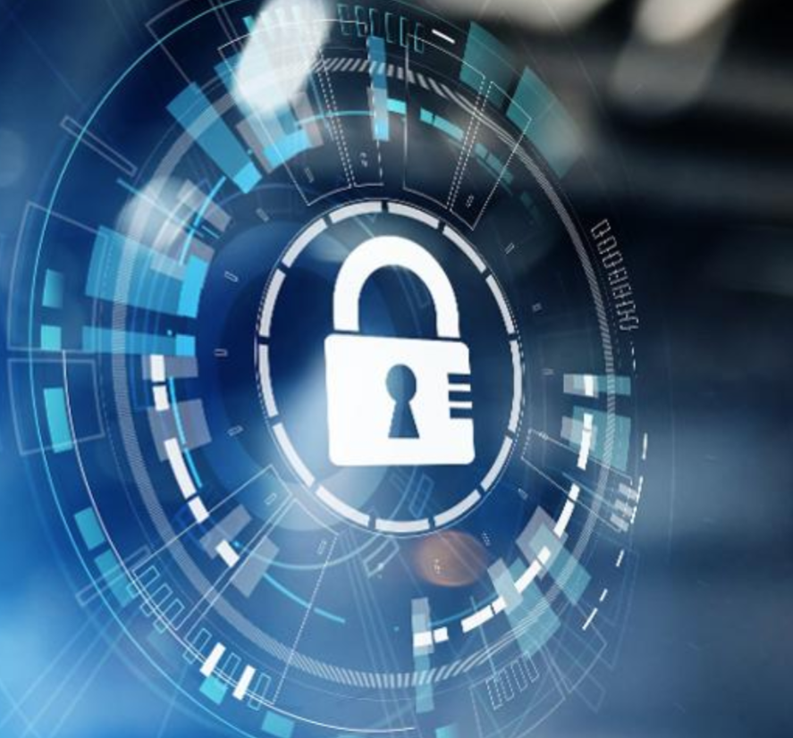
Here are some of the ways to secure your cryptocurrency:
Use a Cold Wallet. Unlike hot wallets, cold wallets do not connect to the internet therefore, they are not prone to cyberattacks.
Use Secure Internet.
Maintain Multiple Wallets.
Secure Your Personal Device.
Change Your Password Frequently.
Two Factor Verification.

Slide 9
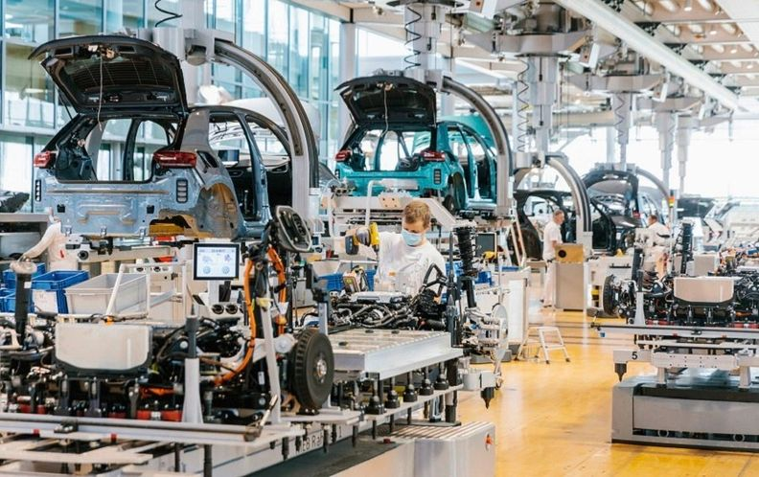
Car Production Halted In Russia
Countries around the world are tightening sanctions against Russia in response to the country’s invasion of Ukraine.
Companies are limiting, halting or fully exiting business activities in Russia, including many automakers.
Many shipping giants and logistics companies, like MSC and Maersk, have suspended container shipping to and from Russia, resulting in automakers needing to halt production.

Slide 10
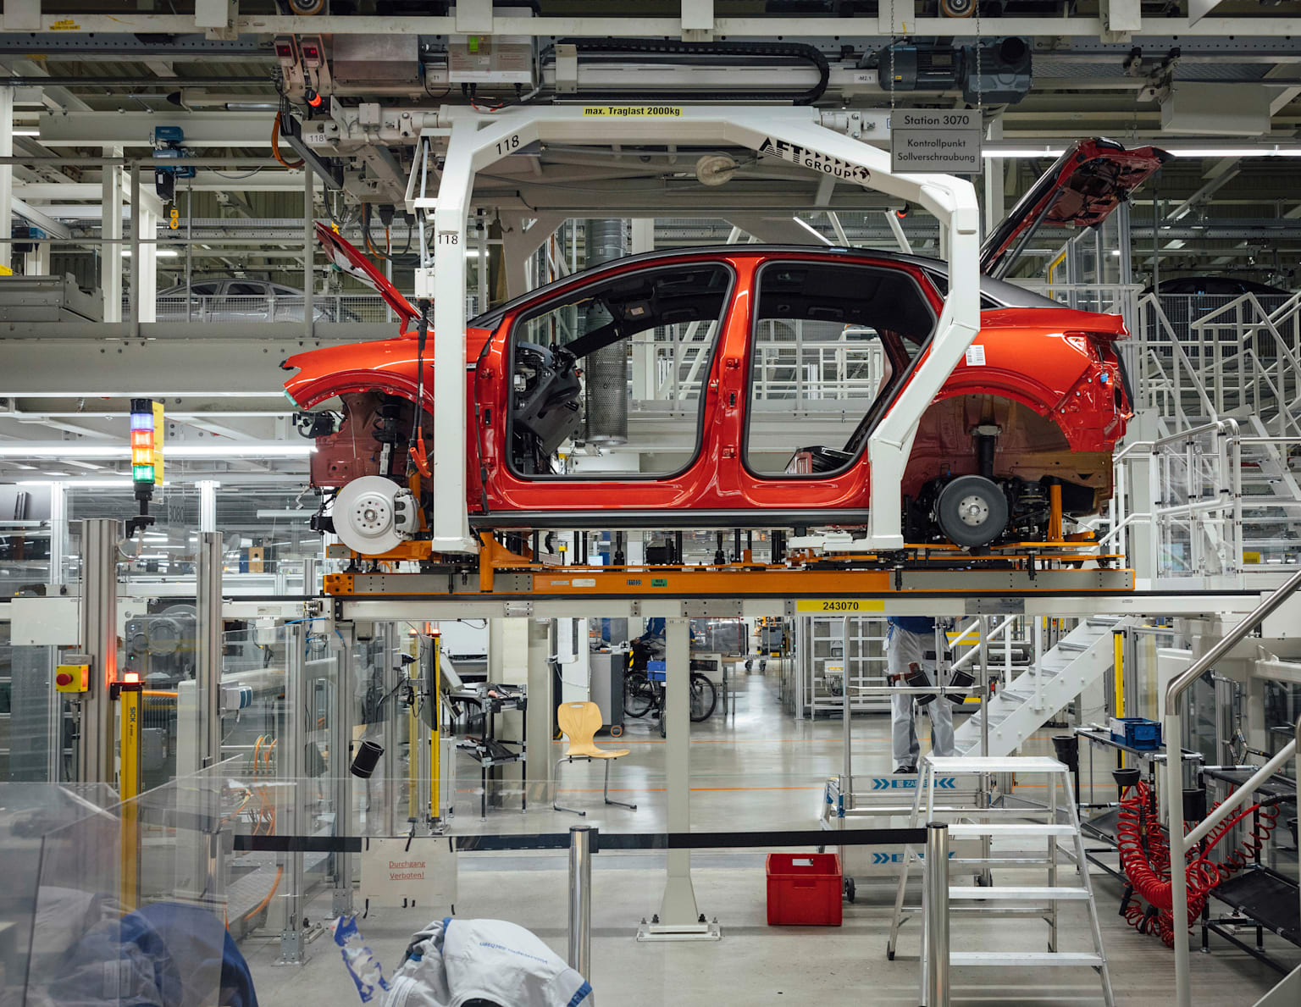
Car Manufacturers Limiting Or Halting Production In Russia:
Toyota
Daimler Truck
Mercedes-Benz
AB Volvo
Ford
Volkswagen
BMW

Slide 11
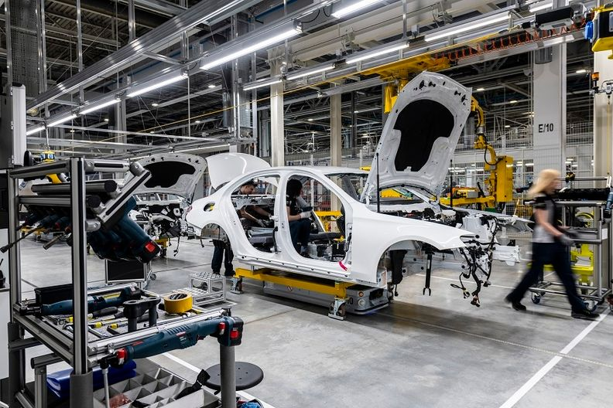
Automakers Import Suspensions On Russia:
General Motors
Harley-Davidson
Jaguar Land Rover
Aston Martin
Honda
BMW

